Slide 1
Peak Detection in Time Series
Presentation of Final Results
Nestor Weidemann, Nathira Wijemanne
Autonomous Multisensor Systems Group
Institute for Intelligent Cooperating Systems
Faculty of Computer Science
Otto von Guericke University Magdeburg
16.09.2025

Slide 2
1.
Introduction
2.
Methodology
3.
Results
4.
5.
Evaluation
Conclusion
Peak Detection in Time Series | N. Weidemann, N. Wijemanne

Slide 3

1. Introduction
2.
3.
4.
5.
Motivation
Sustainability and energy efficiency
Computer Numerical Control (CNC) machines are widely used in modern manufacturing
[1]
Peak Detection in Time Series | N. Weidemann, N. Wijemanne
Notes:
Automated production processes are industry standards
Energy efficiency and machine longevity affect on environmental and economic performance
A milling machine is a tool that uses rotating cutting bits to remove material from a workpiece, shaping it into precise dimensions and features
A CNC machine automates this process by following programmed instructions, allowing for highly accurate and repeatable machining of complex parts

Slide 4
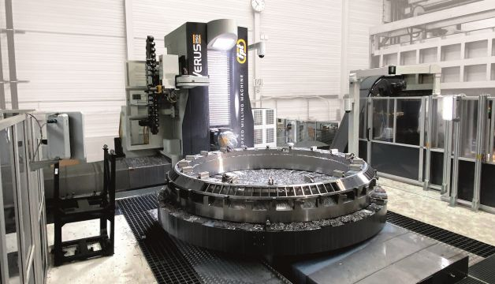
1. Introduction
2.
3.
4.
5.
Problem
Sudden power surges can occur in the motor current of a milling machine
Consequences
Stress on the drive electronics, leading to a reduced motor lifespan
Increase in energy consumption
[2]
Peak Detection in Time Series | N. Weidemann, N. Wijemanne
Notes:
Important to distinguish between normal power increases (e.g. caused by the tool engaging with material) and abnormal peak anomalies

Slide 5
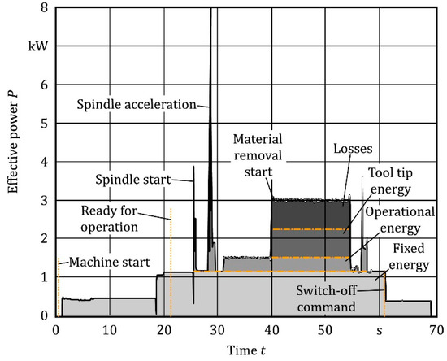
1. Introduction
2.
3.
4.
5.
Task
Implement and compare different approaches for peak detection
Goal
Identify sudden power surges
Detect anomalies or inefficiencies
[3]
Peak Detection in Time Series | N. Weidemann, N. Wijemanne
Notes:
Use Case: Milling Machine
The information can then be used to find errors in the G-Code

Slide 6
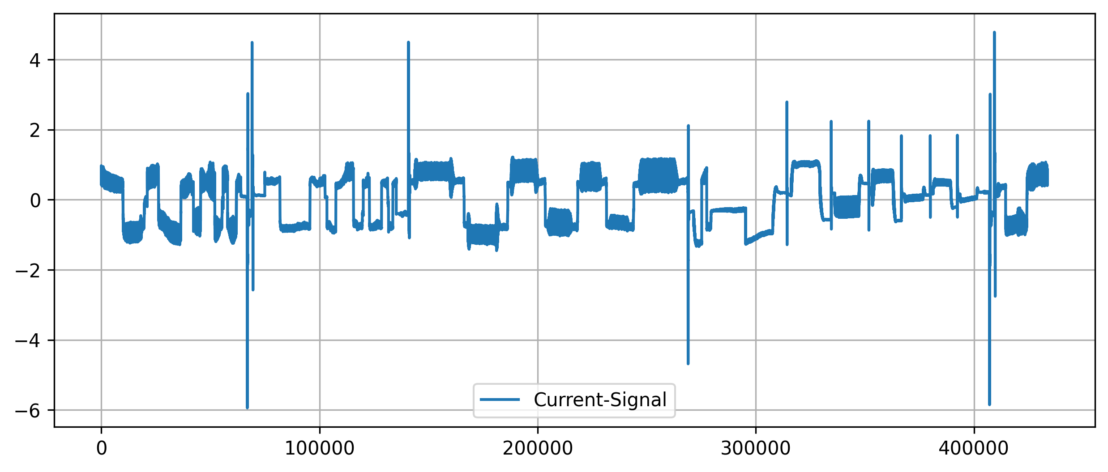
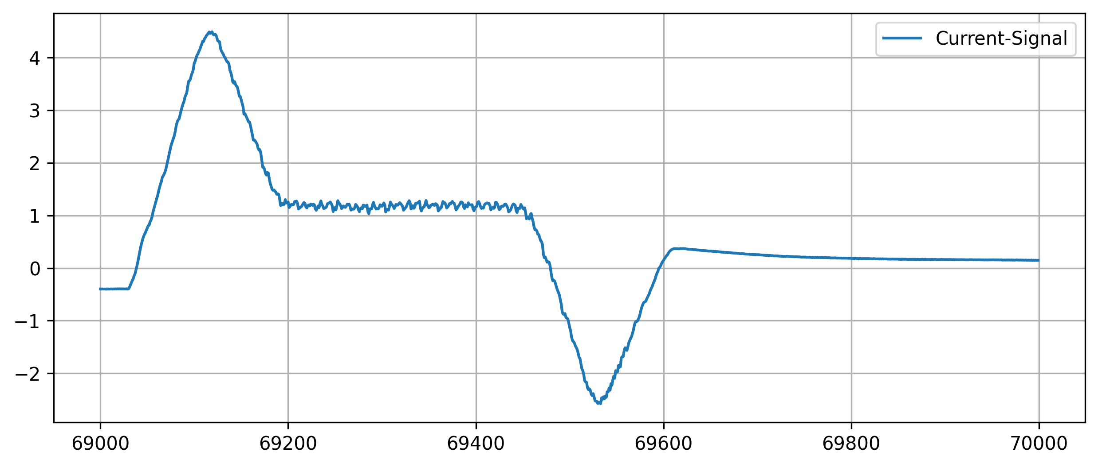
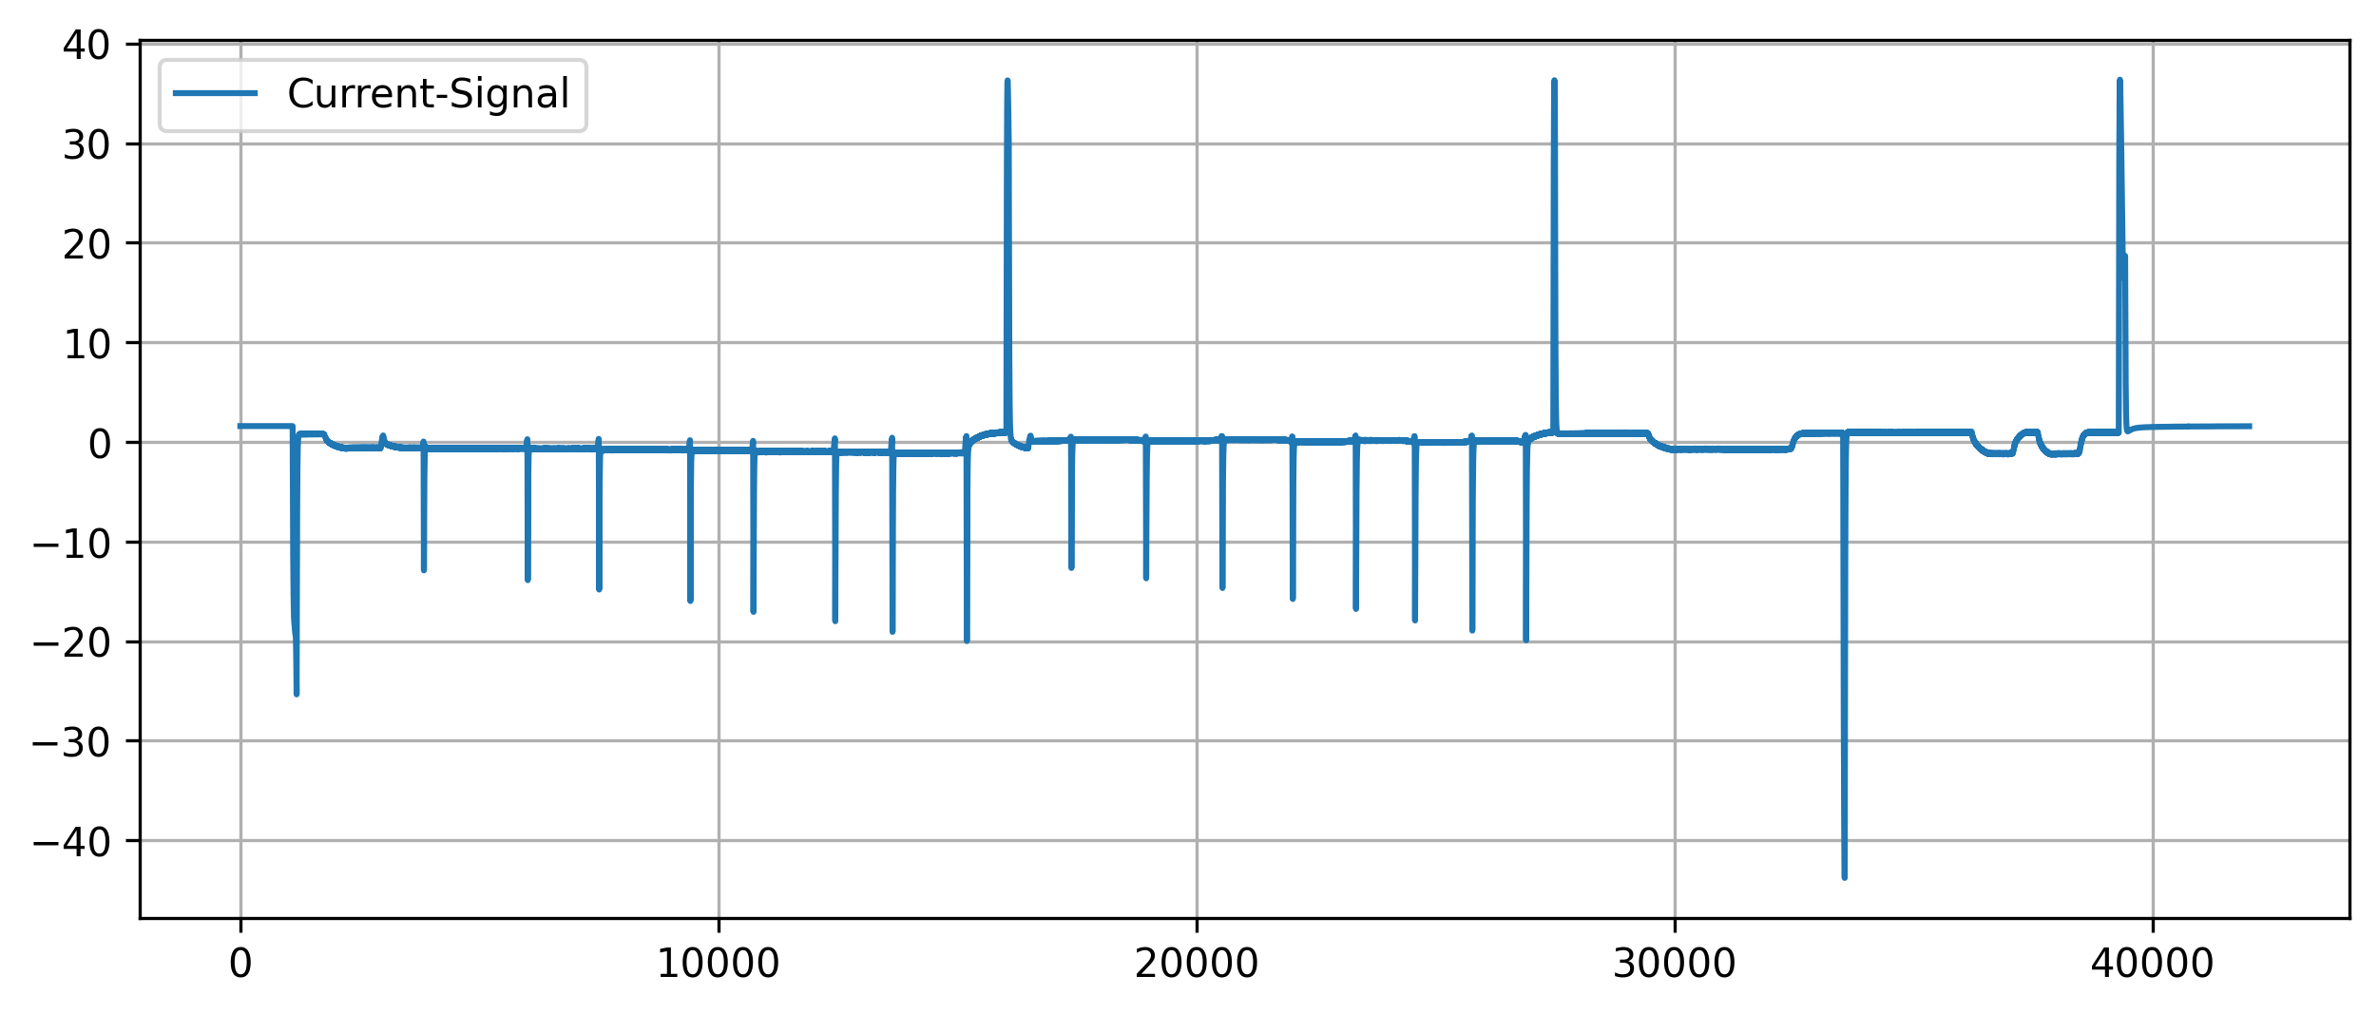
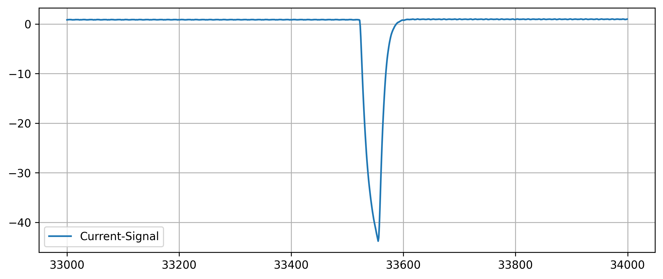
1. Introduction
2.
3.
4.
5.
Analysis of peak characteristics
Peak Detection in Time Series | N. Weidemann, N. Wijemanne
Notes:
Peaks can have different shapes and widths

Slide 7
1.
Introduction
2.
Methodology
3.
Results
4.
5.
Evaluation
Conclusion
Peak Detection in Time Series | N. Weidemann, N. Wijemanne

Slide 8
1.
2. Methodology
3.
4.
5.
Univariate (and linear) methods
Multivariate (and non-linear) methods
Threshold-Based
Moving-Average
Wavelet Transform
K-Means
DBSCAN
Isolation Forest
Autoencoder
Broad variety of techniques from simple to complex and data-driven
Peak Detection in Time Series | N. Weidemann, N. Wijemanne
Notes:
Linear methods assume a linear relationship or operate via linear operations
Nonlinear methods model complex, nonlinear relationships
Univariate methods analyze one time series at a time
Multivariate methods can consider multiple dimensions/features simultaneously

Slide 9
1.
2. Methodology
3.
4.
5.
General Overview of Pipeline
Model Tuning
Visualization
Data Processing
Model Building
Evaluation
Pseudo Labeling
Peak Detection in Time Series | N. Wijemanne

Slide 10
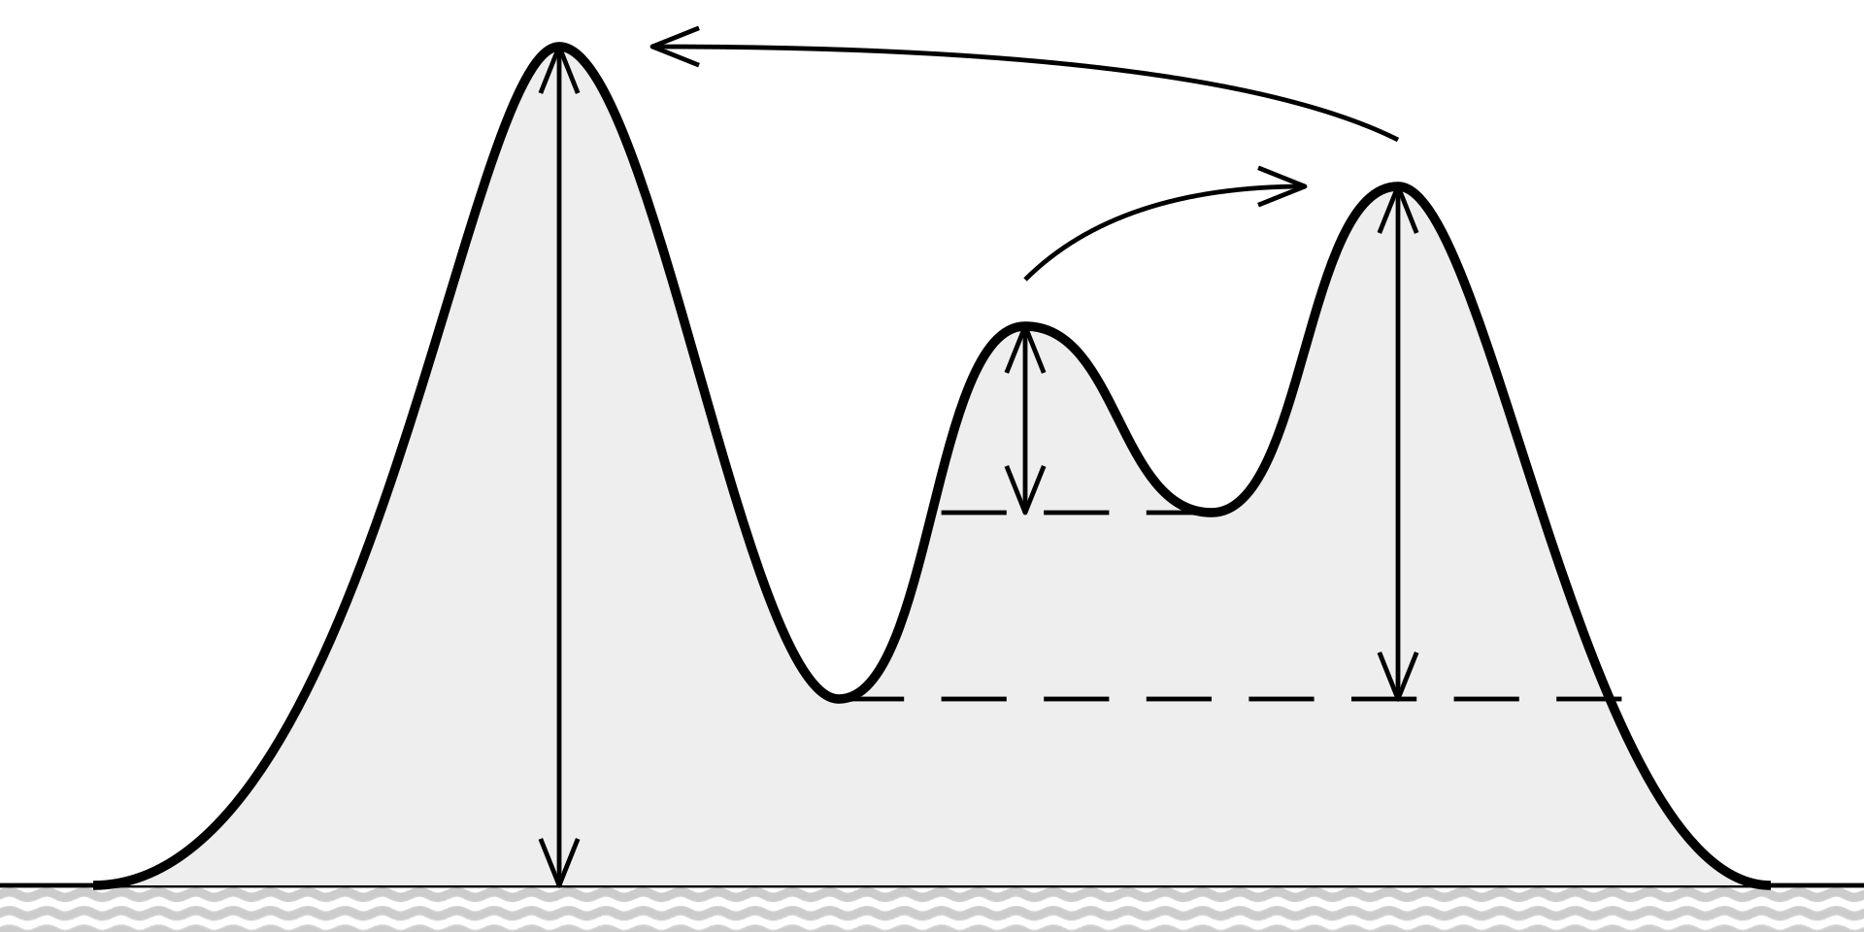
1.
2. Methodology
3.
4.
5.
Threshold-Based Approach
A point is identified as a peak if:
It is a local maximum
Its value exceeds a threshold
Its prominence exceeds a threshold
Input-Feature-Variants
Torque with removed DC-offset
Absolute gradient of the command-speed
[4]
Peak Detection in Time Series | N. Weidemann
Notes:
Parameters: value-threshold, prominence-threshold
Prominence measures how much a peak stands out from surrounding valleys
A peak's prominence is the vertical distance between the peak and the lowest contour line that surrounds it and contains no higher peak
Higher prominence = more significant or isolated peak
Local maximum check: implicitly a window-size of 3

Slide 11
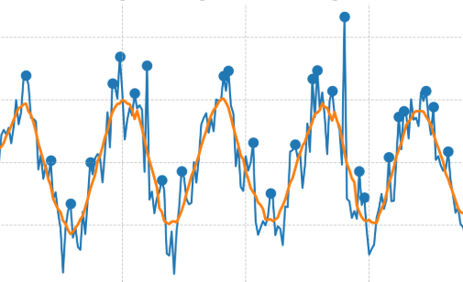
1.
2. Methodology
3.
4.
5.
Moving-Average-Based Approach
Apply Moving-Average-Smoothing
Determine the difference to the original signal
Check for local maxima that exceed the threshold
Peak Detection in Time Series | N. Weidemann
Notes:
Parameters: window size, threshold for peak
Input feature: torque

Slide 12
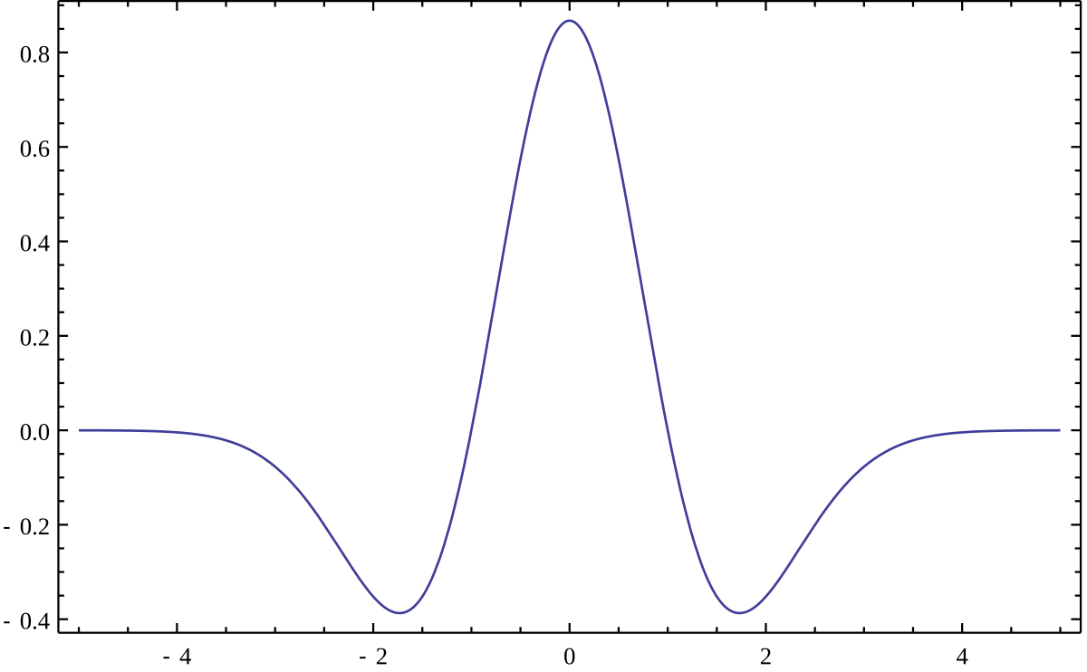
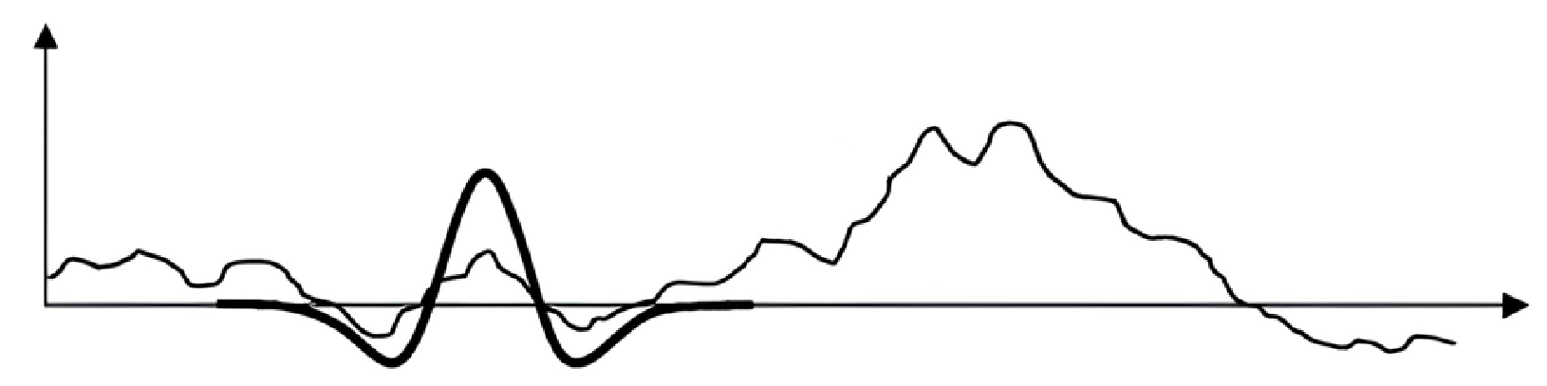
1.
2. Methodology
3.
4.
5.
Wavelet Transform
Using the Ricker wavelet as a basis function
Scale the wavelet and apply convolution on the target signal
High response indicates strong similarity
[5, 6]
Peak Detection in Time Series | N. Weidemann
Notes:
Parameters: width/scale of the wavelet, (response-percentile)
Scipy considers every response in the lower 10th-percentile as noise
Convolution: shift -> normalize (local) -> dot-product
Matrix: coefficients across different scales (frequencies) and positions (time)
Peaks appear as strong, aligned coefficients across multiple scales
Scipy uses a signal-to-noise ratio logic implicitly to judge peak strength

Slide 13
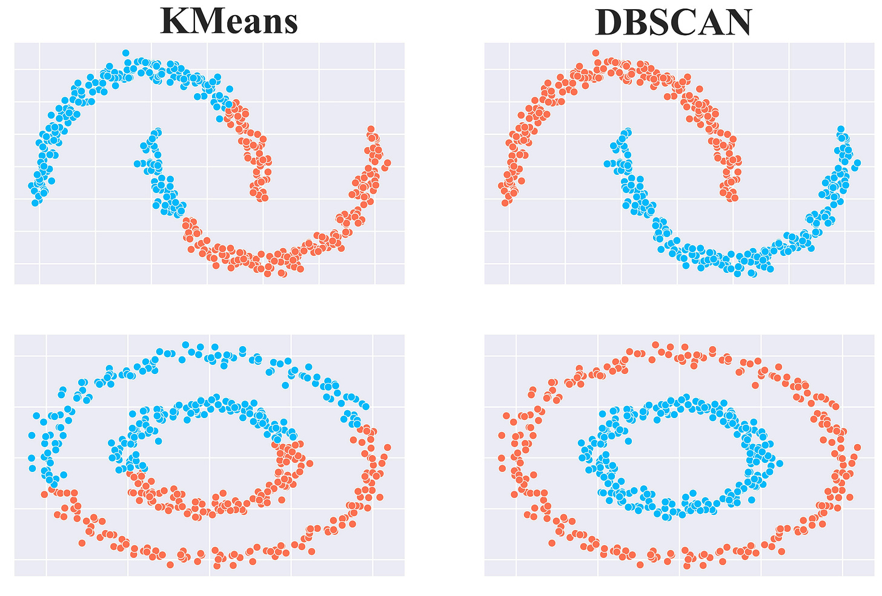
1.
2. Methodology
3.
4.
5.
Clustering with K-Means
Training an autoencoder
Using Encoder to transform inputs into latent-space
Randomly initialize K centroids
Assign each point to the nearest centroid
Recompute the centroids by calculating the mean of all points assigned to it
[7]
Peak Detection in Time Series | N. Weidemann
Notes:
Parameters: number of clusters “k”
Autoencoder tries to reproduce the input
Repeat until changes in cluster assignments are minimal
Partitioning the data into k groups based on minimizing the distance between points and their assigned cluster centroids

Slide 14
1.
2. Methodology
3.
4.
5.
Clustering with DBSCAN (Density-Based Spatial Clustering of Applications with Noise)
Training an autoencoder
Using Encoder to transform inputs into latent-space
Grouping together points that are closely packed
Marking those as outliers that lie alone in low-density regions
[7]
Peak Detection in Time Series | N. Weidemann
Notes:
Parameters: epsilon controls the radius of neighborhood (distance threshold)

Slide 15
1.
2. Methodology
3.
4.
5.
Isolation Forest
Create random splits to isolate all data points
Compute the anomaly score
Determine the outliers using a threshold for the score
Outlier
Regular data point
Peak Detection in Time Series | N. Wijemanne
Notes:
Key parameter: contamination, number of trees
Uses Extremely Randomized Tree Regressors to separate anomalies from the rest of the data
Calculates an anomaly score for each data point and checks with a threshold. score depends on avg path length of an isolated point and average depth of all data points. closer to 1, strong anomaly
Does not assume the distribution
However, not built for timeseries data

Slide 16
1.
2. Methodology
3.
4.
5.
Autoencoder
Training an autoencoder
Compute the reconstruction error
Identify peaks based on a threshold for the error
Encoder
Latent space
Decoder
Peak Detection in Time Series | N. Wijemanne
Notes:
An autoencoder is a neural network model that seeks to learn a compressed representation of an input, known as the latent space. And the decoder tries to recreate the features based on the compressed representation. The goal is to minimize the difference between the original and reconstructed data.
Long Short-Term Memory, or LSTM, network are specifically designed to support sequences of input data.
If the reconstructed output is different from the original input, it can show an anomaly or outlier which makes autoencoders useful for fraud detection and system monitoring.
LSTM training is slower than CNNs
Hyperparameters: Number of layers/units, Sequence length, Learning rate, Dropout Batch size
Other parameters: reconstruction error threshold → IQR/percentile etc.
Detects anomalies for multivariate timeseries data by learning non-linear patterns
LSTMs – designed for sequences

Slide 17
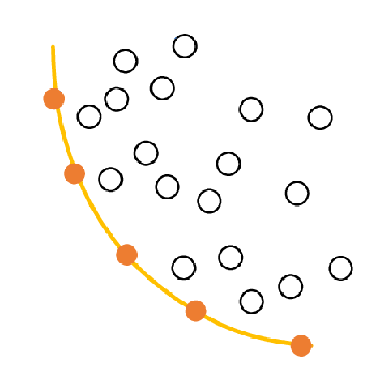
1.
2. Methodology
3.
4.
5.
Determining the parameters
The quality of the parameters is estimated purely from statistical metrics:
Total number of peaks
Mean peak height
Mean peak prominence
Count of sequences without peaks
Using Pareto-Front-Analysis to select the best solution
[8]
Peak Detection in Time Series | N. Weidemann, N. Wijemanne
Notes:
No ground truth available
Multi-Objective Optimization with Pareto-Front
Reason for use: majority of people use this in papers
Count of sequences without peaks -> indicating missed detections
Total number of peaks -> indicating sensitivity
Average peak height -> indicating proportion of true-positives
Average peak prominence -> indicating significance of the peaks

Slide 18
1.
Introduction
2.
Methodology
3.
Results
4.
5.
Evaluation
Conclusion
Peak Detection in Time Series | N. Weidemann, N. Wijemanne

Slide 19
1.
2.
3. Results
4.
5.
Method | Features | Parameters |  | PC | MH | MP | SWP
Threshold-Based | Torque | Threshold = 5 | Min-Prominence = 1.1 | 2977 | 5.03 | 0.89 | 0
Threshold-Based | Cmd.-Speed | Threshold = 0.7 | Min-Prominence = 1.1 | 660 | 6.74 | 0.13 | 0
Moving-Average | Torque | Window = 1250 | Threshold = 2.0 | 56111 | 1.89 | 0.13 | 1
Wavelet Transform | Torque | Min-Width = 100 | Max-Width = 150 | 4964 | 0.88 | 0.05 | 0
K-Means | Cmd.-Speed | K-Clusters = 2 |  | 365670 | 1.2 | 0.09 | 0
DBSCAN | Torque | Epsilon = 3.5 |  | 91936 | 3.2 | 0.16 | 0
Isolation Forest | Torque | Estimators = 100 | Contamination = 0.01 | 73476 | 4.37 | 0.08 | 0
Autoencoder | All inputs | Latent Dims = 8 | Contamination = 0.01 | 33600 | 0.03 | 2.85 | 0
PC: Peak-Count MH: Mean Height MP: Mean Prominence SWP: Sequences Without Peaks
Peak Detection in Time Series | N. Weidemann, N. Wijemanne
Notes:
Optimal compromise between all metrics
Best tradeoff between amplitude and prominence with a more realistic peak count
It is common to manually checking each sample if it is challenging to generate ground truth data
Examples:
Robust multi-lane detection and tracking using adaptive threshold and lane classification
Robust lane detection and tracking with RANSAC and Kalman filter: „defining a ground truth for the data is extremely tedious; hence, it is commonly avoided. Consequently, detections were qualitative and based purely on visual inspection by single user”

Slide 20
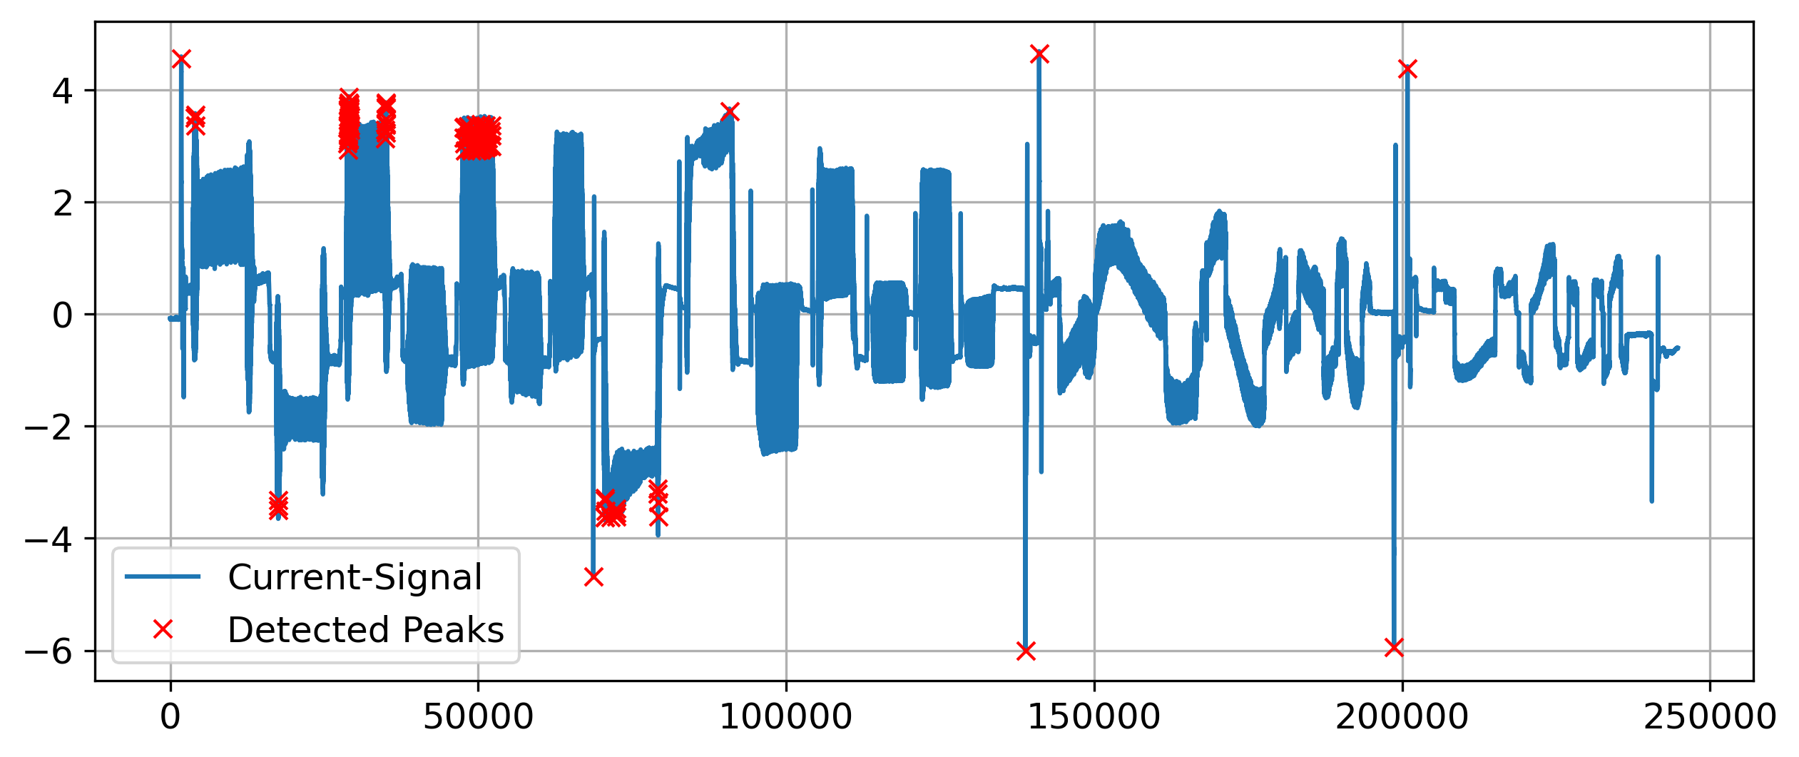
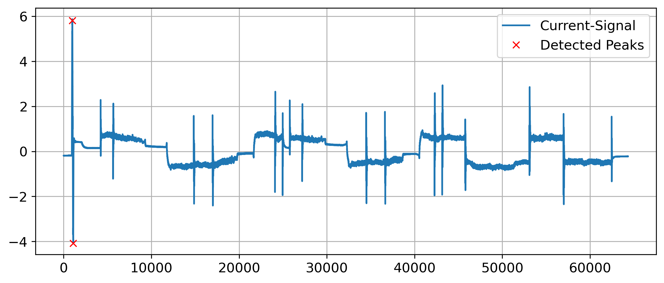
1.
2.
3. Results
4.
5.
Threshold-Based Detection (Torque)
Peak Detection in Time Series | N. Weidemann, N. Wijemanne
Notes:
Good precision on easy examples with large outliers but fails on others with many false-positives -> bad generalization
Few true peaks were undetected
Predicting one precise position and not an area
Can detect positive and negative peaks
Example-pictures: Seq2 ax1 Seq5 ax1

Slide 21
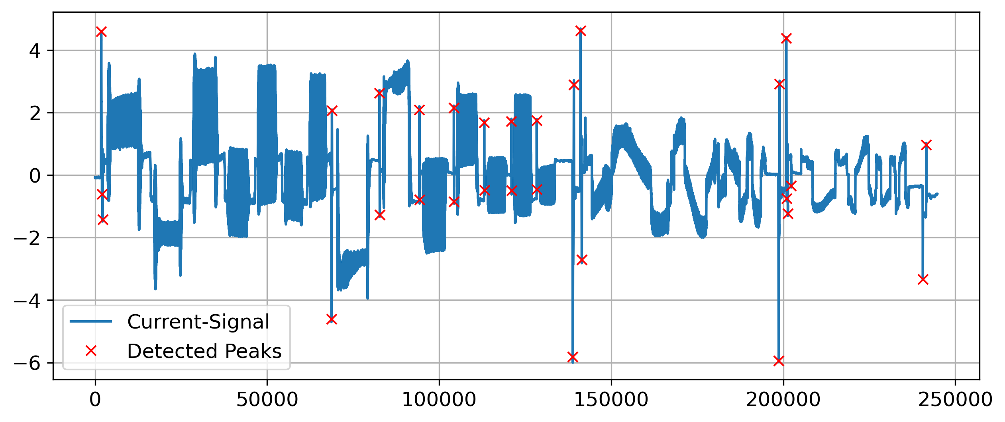

1.
2.
3. Results
4.
5.
Threshold-Based Detection (Cmd.-Speed)
Peak Detection in Time Series | N. Weidemann, N. Wijemanne
Notes:
Very high precision -> no false-positives
Most of the true peaks were detected but not all (especially peaks with a smaller amplitude)
Predicting one precise position and not an area
Can detect positive and negative peaks
Example-pictures: Seq2 ax1 Seq5 ax1

Slide 22
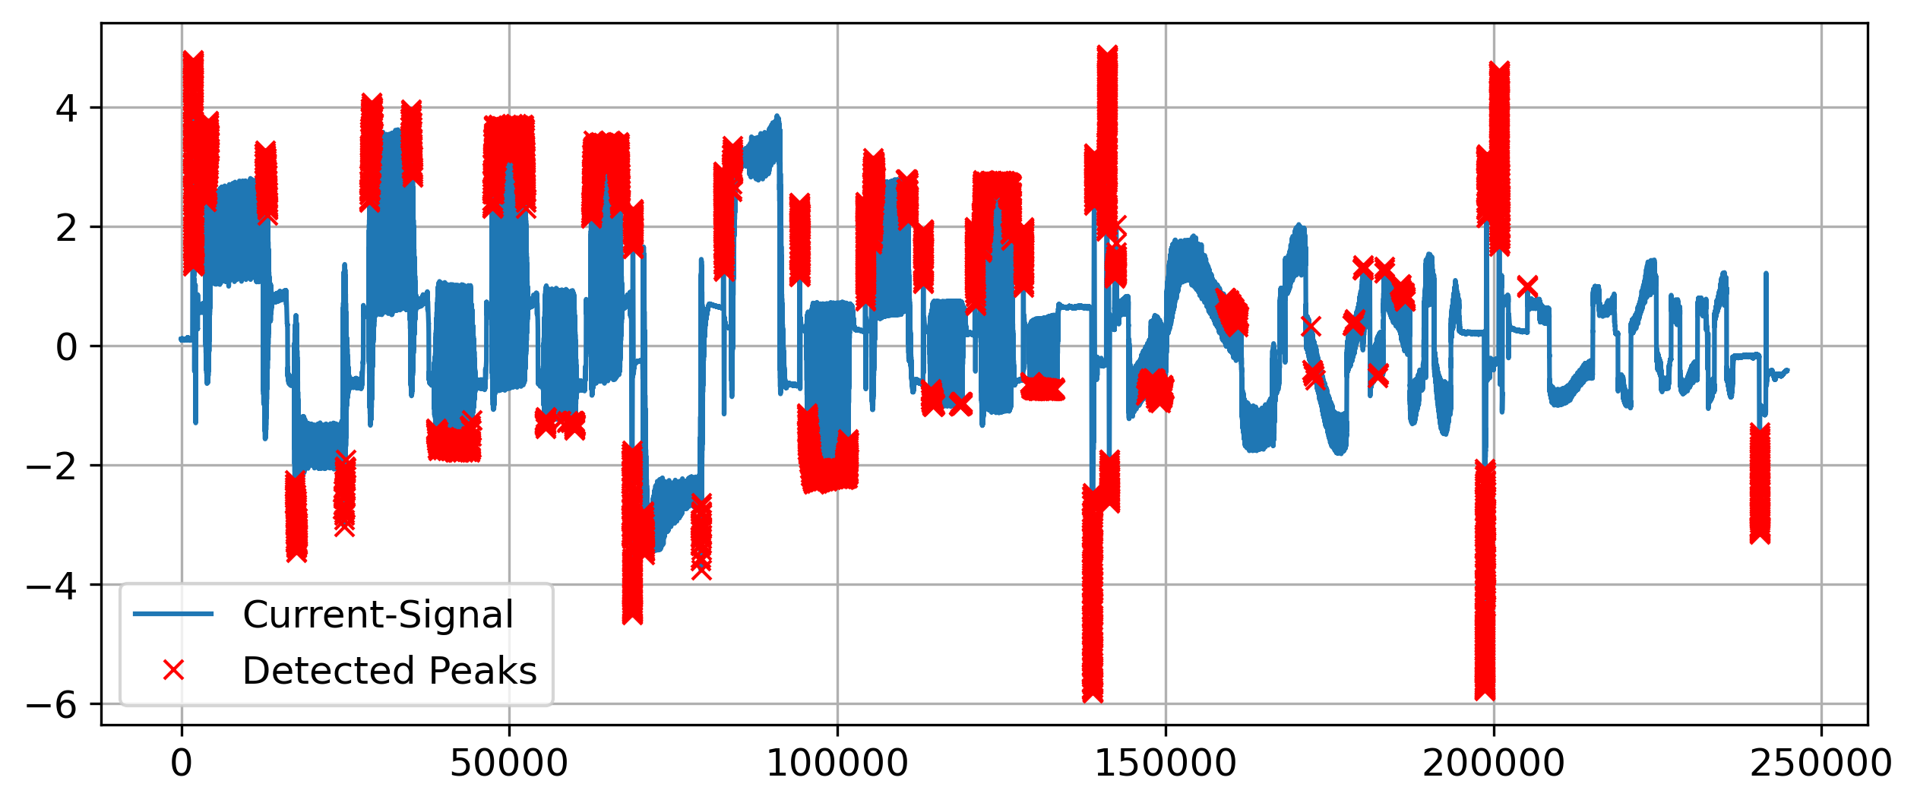
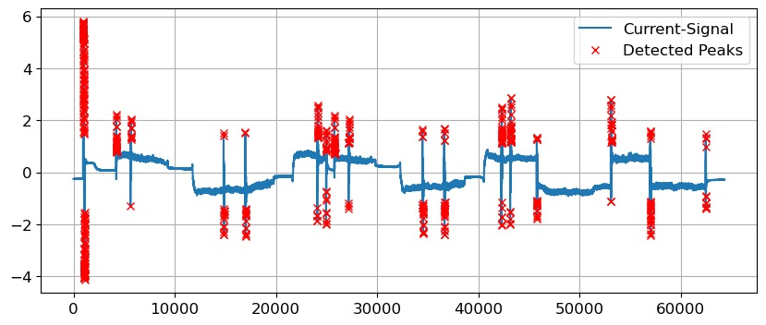
1.
2.
3. Results
4.
5.
Moving-Average-Based Detection
Peak Detection in Time Series | N. Weidemann, N. Wijemanne
Notes:
Identifies most of the peaks
Was only unable to properly detect a specific pattern – brings down average of metrics
bad generalization, if threshold can be specified for each machine type, would work better.
Can detect positive and negative peaks
Example-pictures: Seq2 ax1 Seq5 ax1

Slide 23
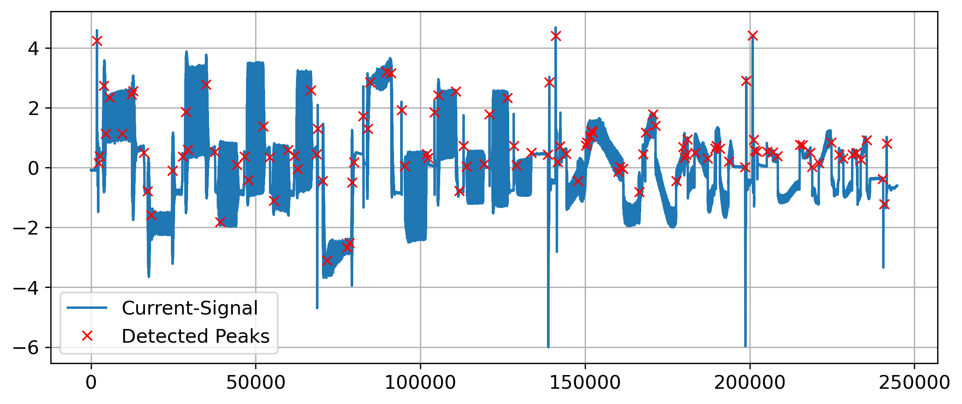
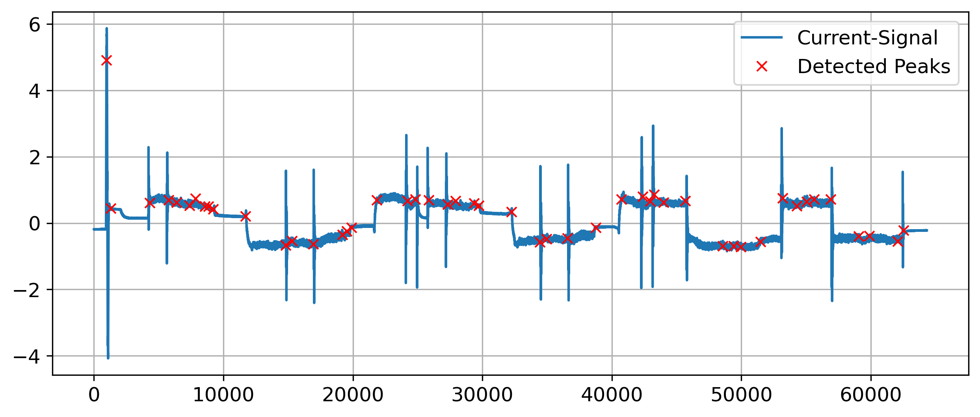
1.
2.
3. Results
4.
5.
Wavelet Transform
Peak Detection in Time Series | N. Weidemann, N. Wijemanne
Notes:
Very bad precision -> many false-positives
Most of the true peaks were detected but not all
Predicting one precise position and not an area
Can detect only positive peaks (with one single wavelet)
Possible reasons of failure:
Peaks have different shapes and widths
Shape is indistinguishable from noise
Example-pictures: Seq2 ax1 Seq5 ax1

Slide 24
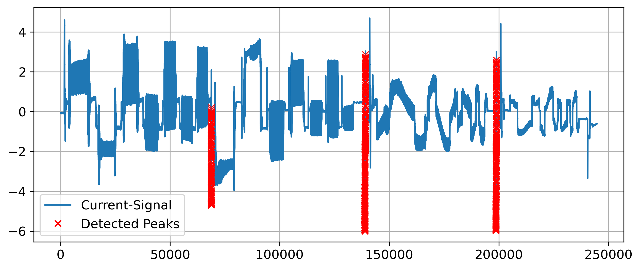
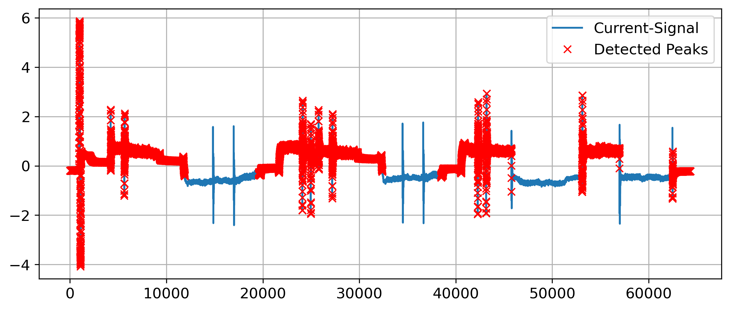
1.
2.
3. Results
4.
5.
Clustering with K-Means
Peak Detection in Time Series | N. Weidemann, N. Wijemanne
Notes:
False-positives issues on some sequences
Many peaks were undetected
Unreliable predictions
Can detect positive and negative peaks
Marking the whole peak area instead of just one precise position
Example-pictures: Seq2 ax1 Seq5 ax1

Slide 25
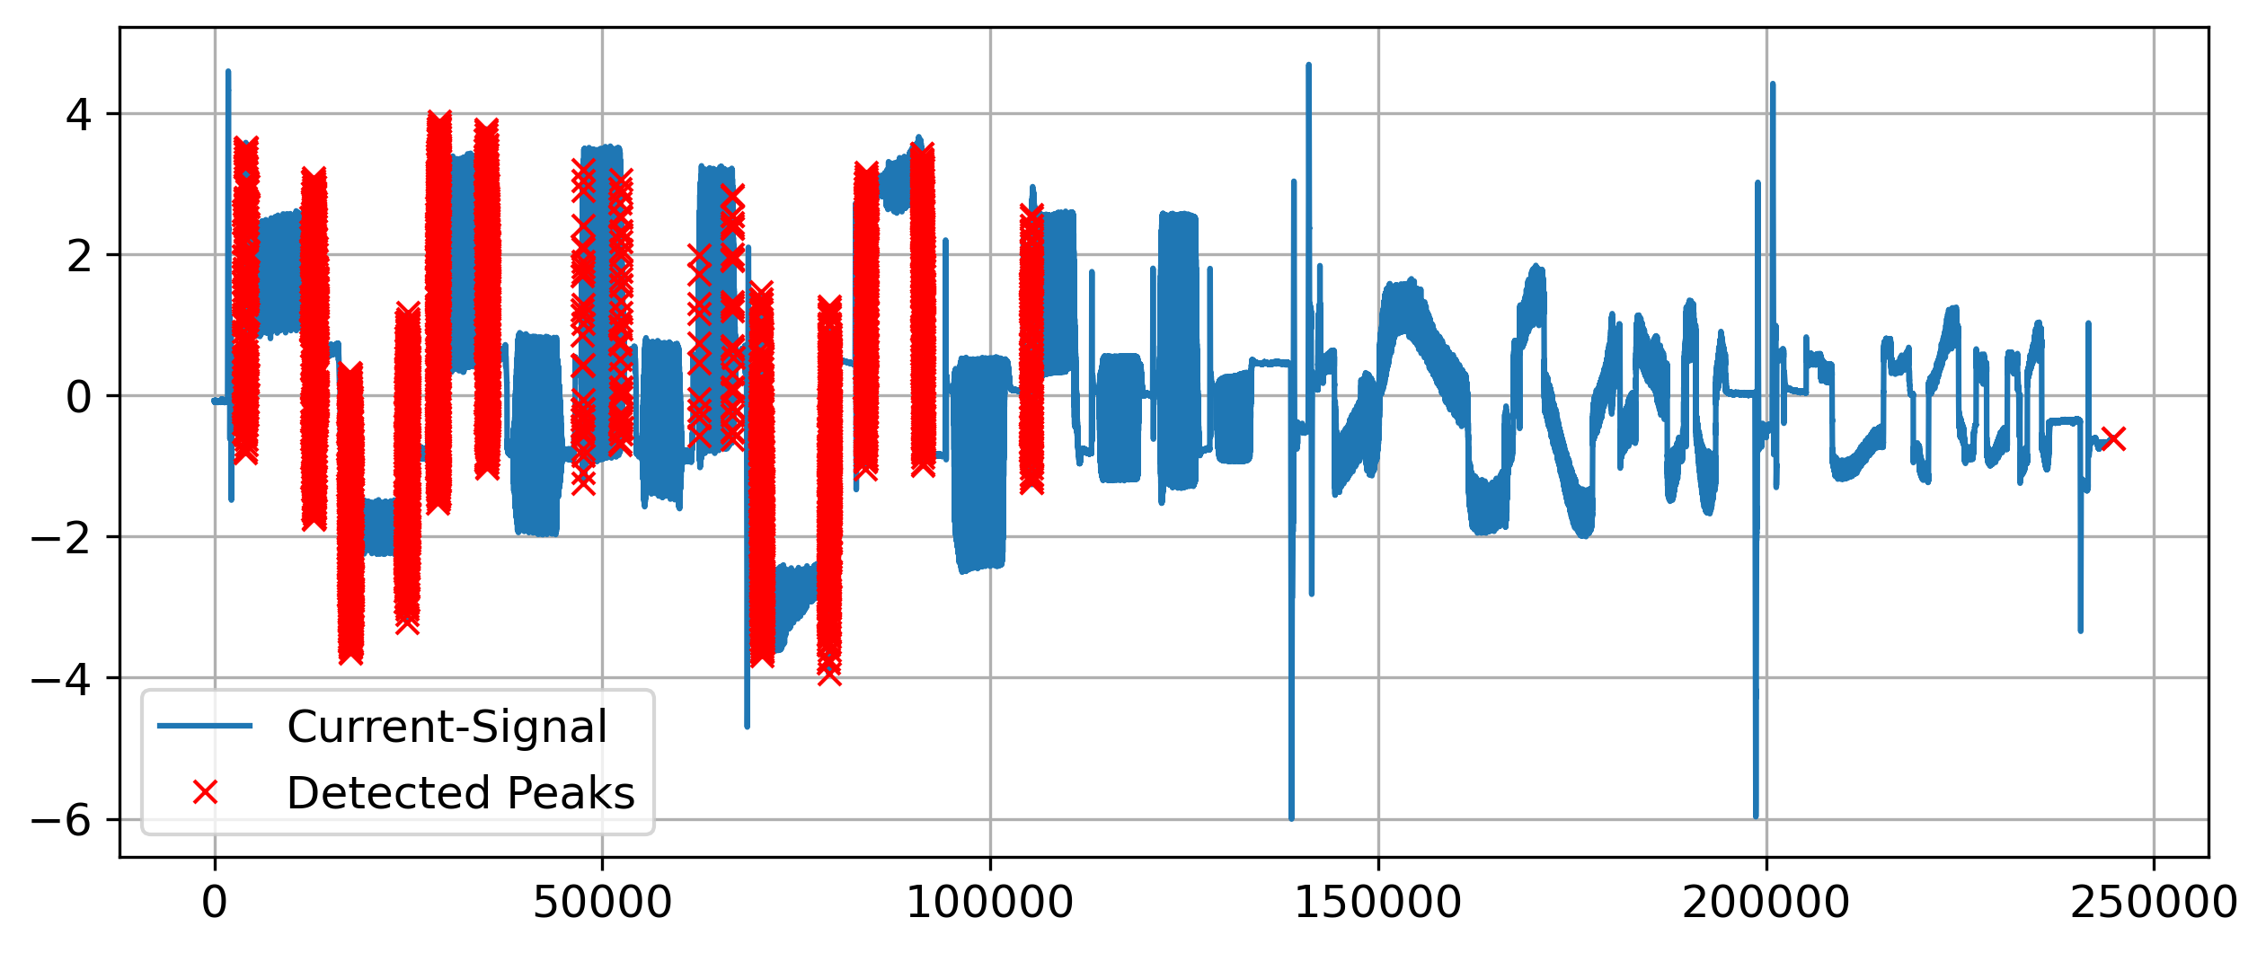
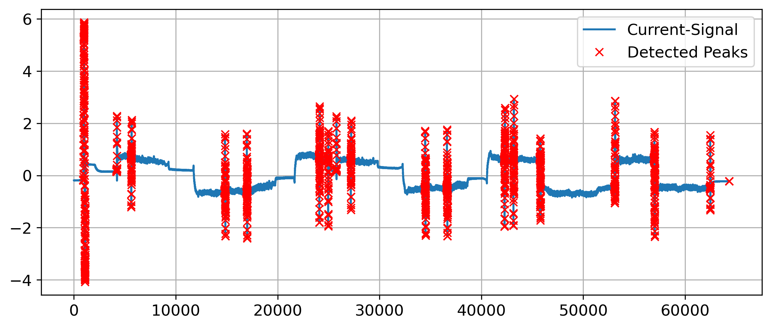
1.
2.
3. Results
4.
5.
Clustering with DBSCAN
Peak Detection in Time Series | N. Weidemann, N. Wijemanne
Notes:
High precision -> almost no false-positives
Some peaks were not detected
Recognizable tendency of detecting peaks
Marking the whole peak area instead of just one precise position
Can detect positive and negative peaks
Example-pictures: Seq2 ax1 Seq5 ax1

Slide 26
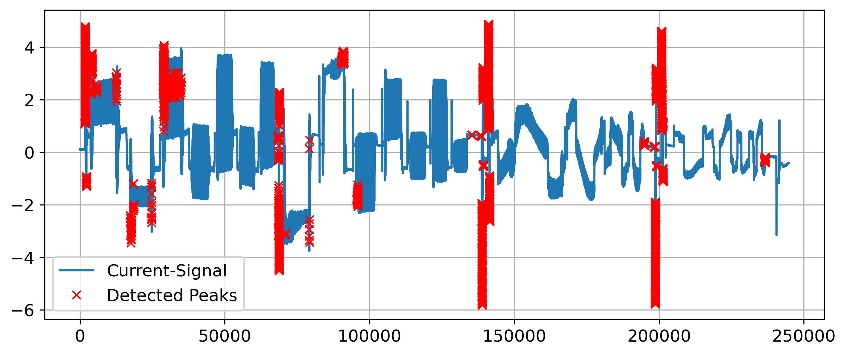
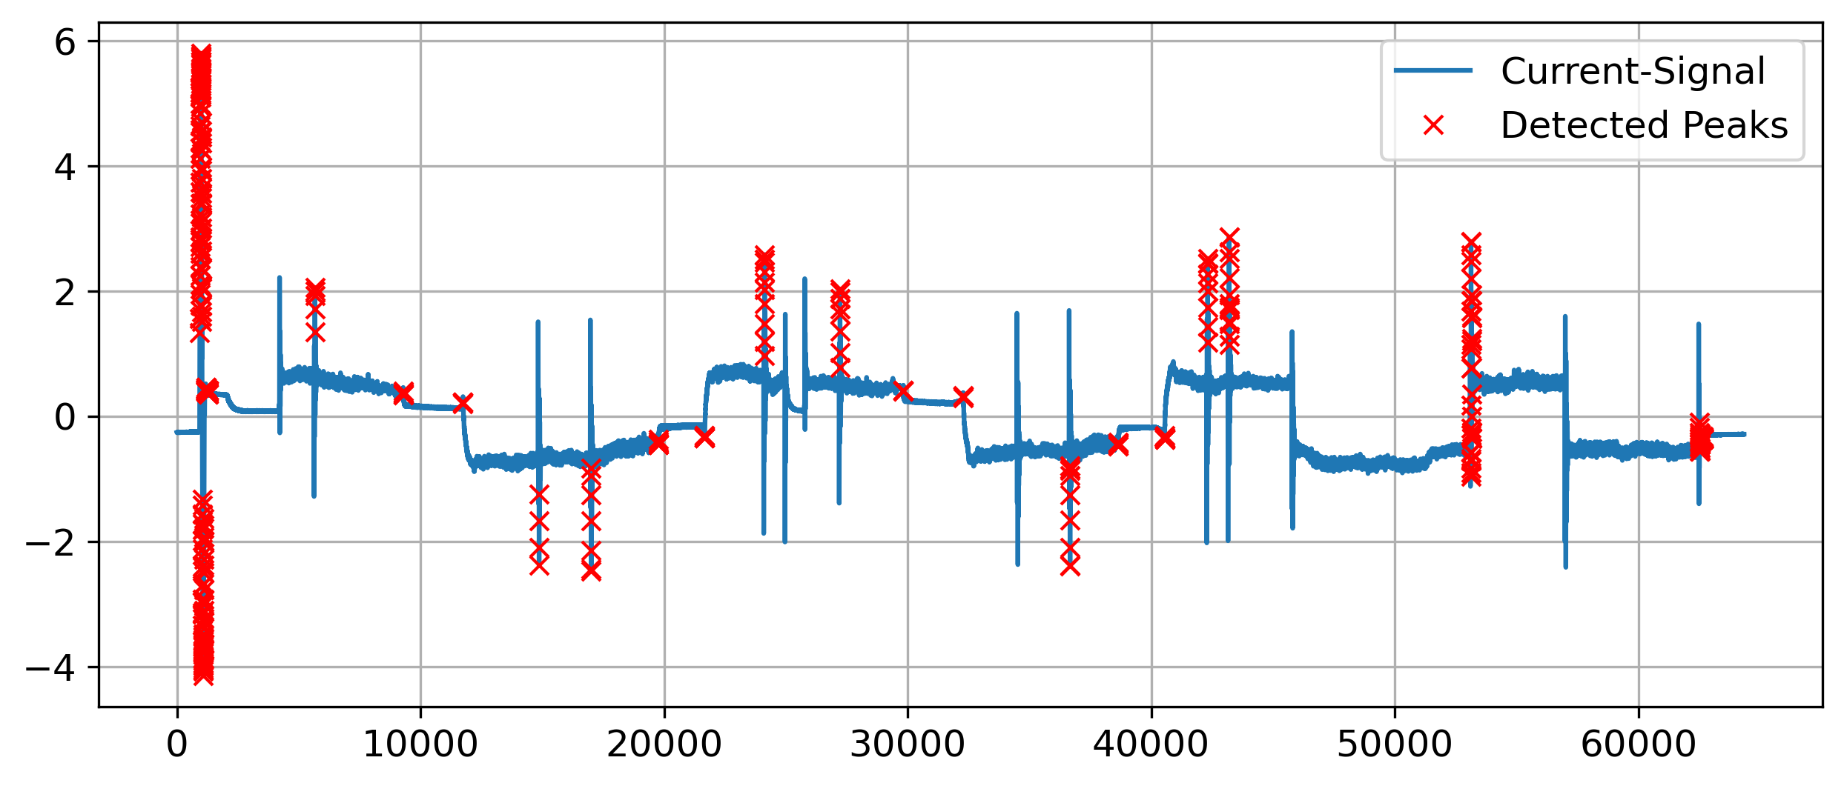
1.
2.
3. Results
4.
5.
Isolation Forest
Peak Detection in Time Series | N. Weidemann, N. Wijemanne
Notes:
Not many false-positives issued on the sequences
Many peaks were not detected
Characteristic of marking the whole peak area instead of just one precise position
Can detect positive and negative peaks

Slide 27
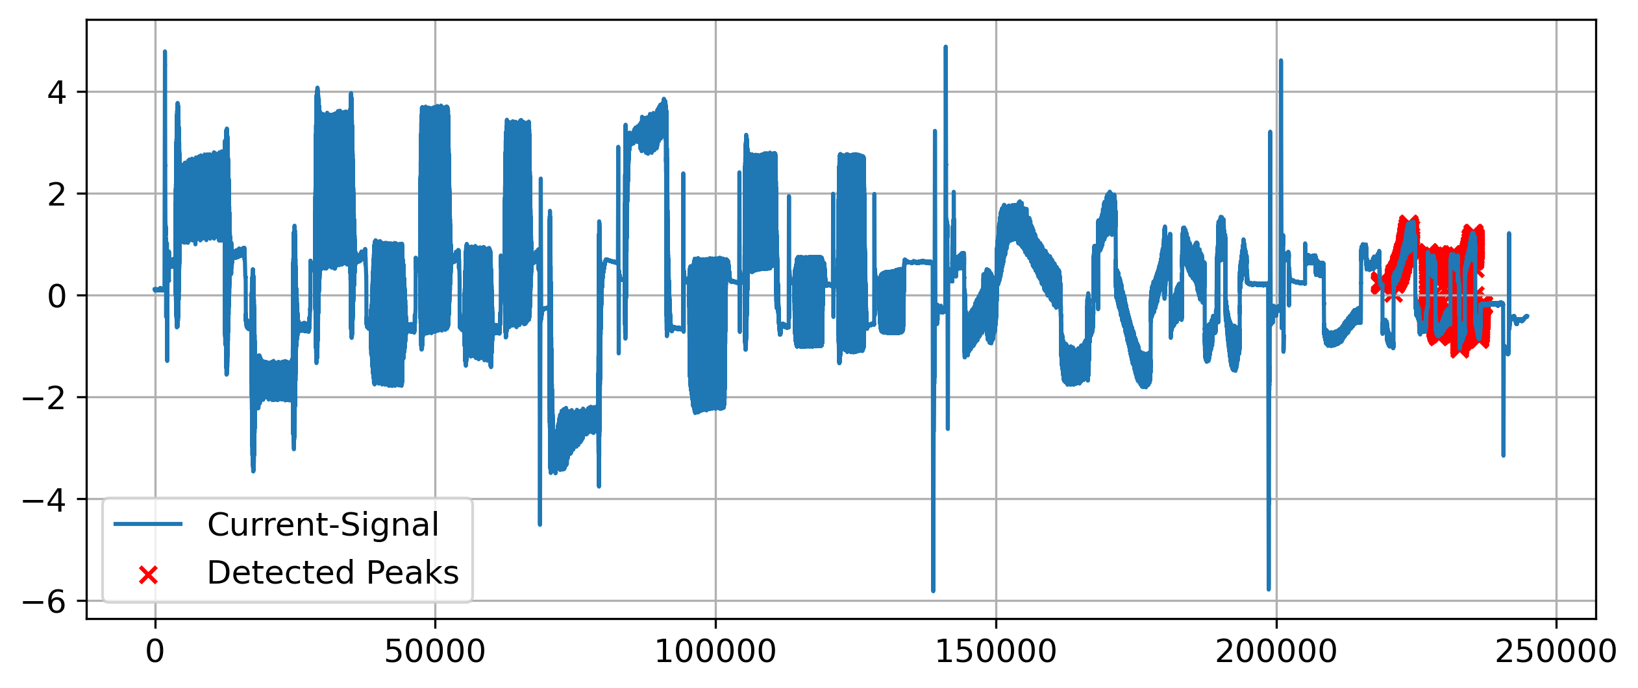
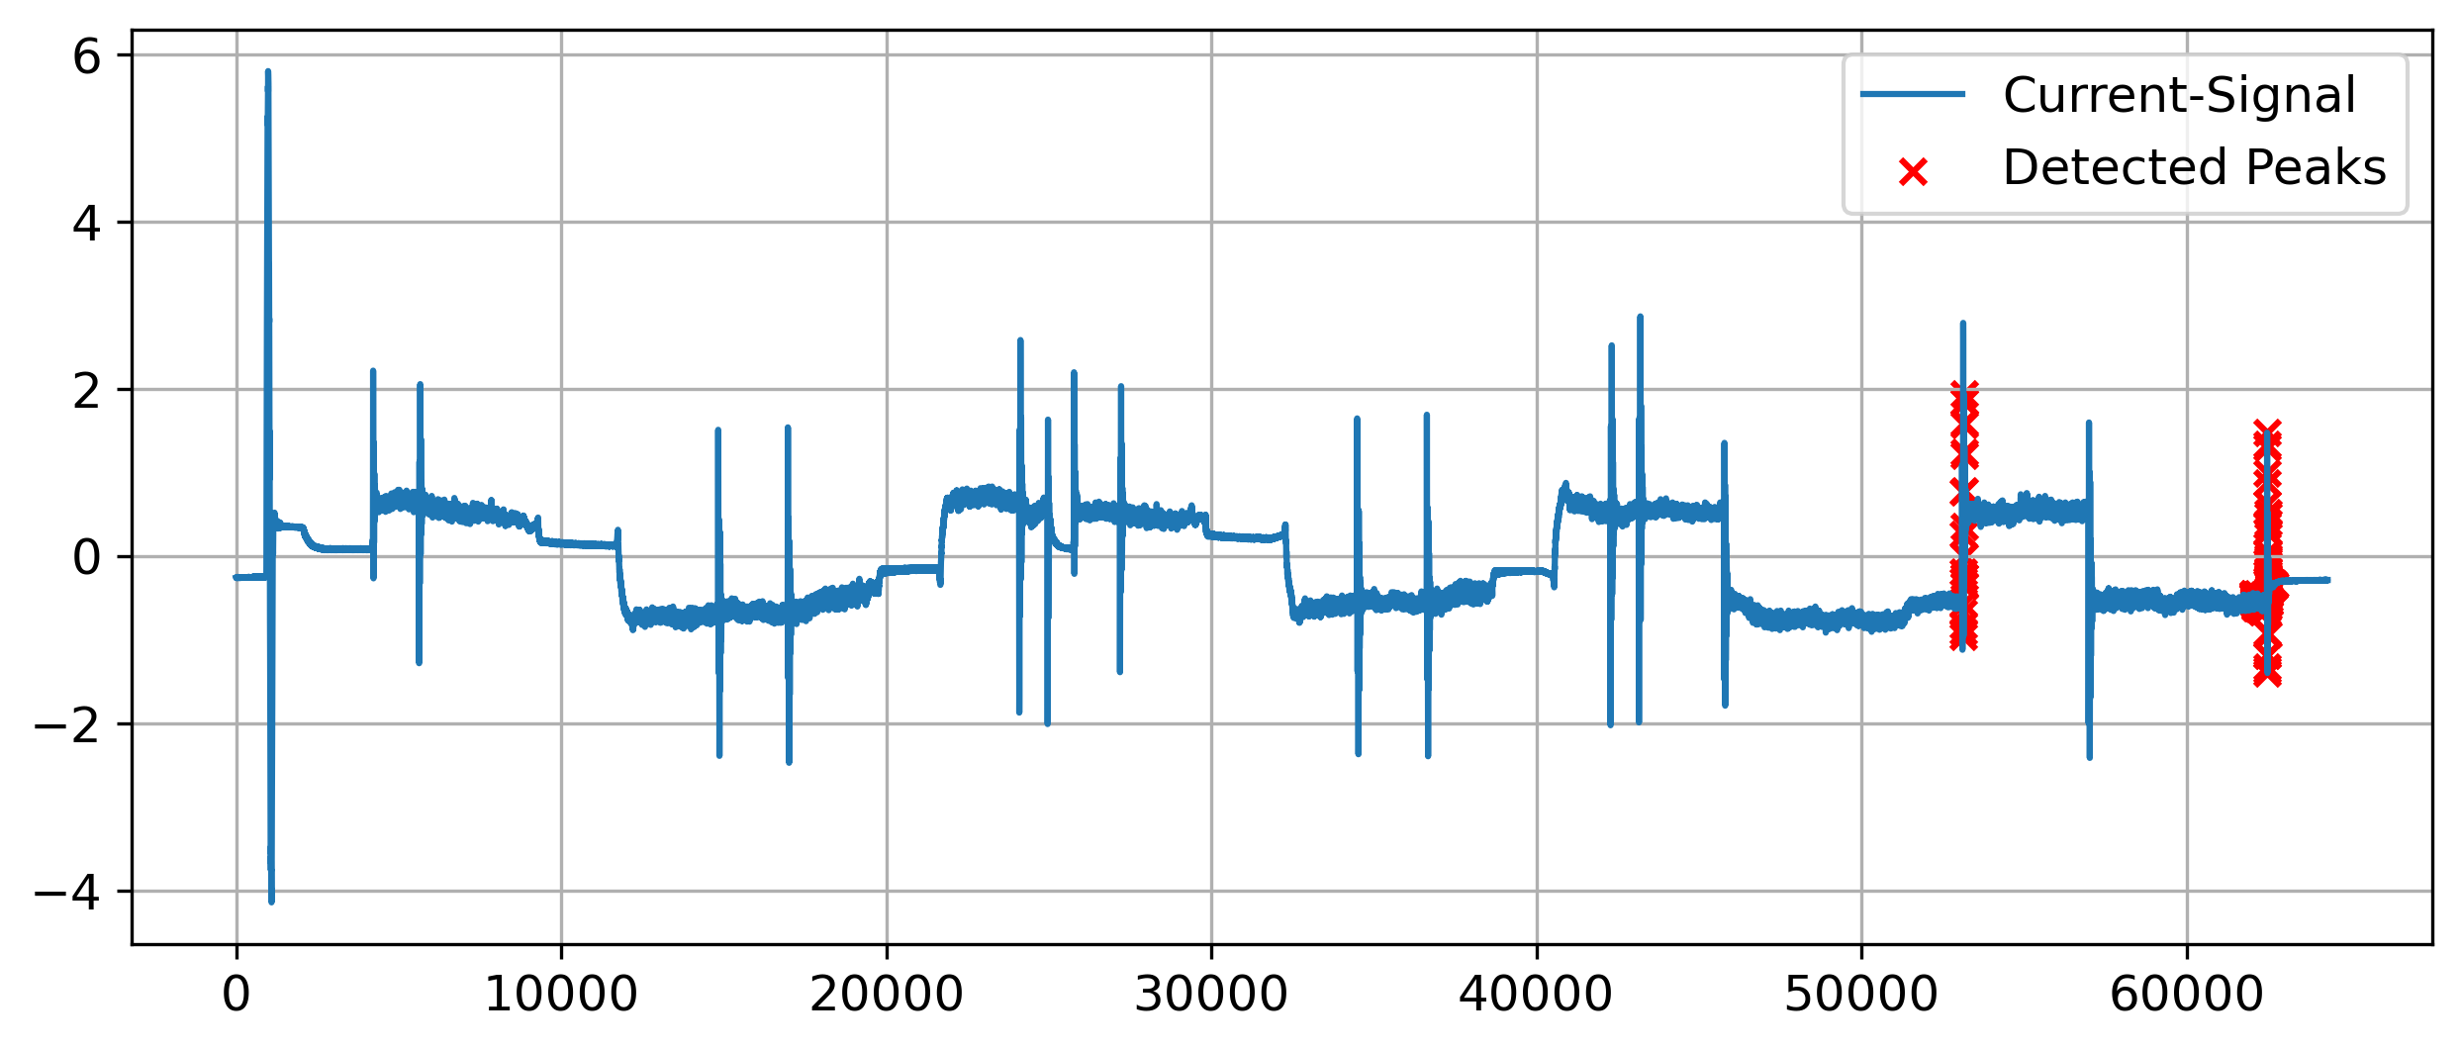
1.
2.
3. Results
4.
5.
Autoencoder
Peak Detection in Time Series | N. Weidemann, N. Wijemanne
Notes:
High precision
Not many false-positives issued on the sequences
Many peaks were not detected
Can detect positive and negative peaks
Detects smaller deviations but sometimes unable to identify larger deviations → not good
Example-pictures: Seq2 ax1 Seq5 ax1

Slide 28
1.
Introduction
2.
Methodology
3.
Results
4.
5.
Evaluation
Conclusion
Peak Detection in Time Series | N. Weidemann, N. Wijemanne

Slide 29
1.
2.
3.
4. Evaluation
5.
Key criteria
Precision and recall
Computational costs and complexity
Generalization and robustness
Applicability
Peak Detection in Time Series | N. Weidemann, N. Wijemanne

Slide 30
1.
2.
3.
4. Evaluation
5.
Comparison with Pseudo Labels
Peak Detection in Time Series | N. Weidemann, N. Wijemanne
Notes:
Metrics just show how similar the prediction is to the percentile-approach
Low recall for all methods that predict precise positions and not an area
Threshold-Based Torque has high precision because it uses the “same” feature as the percentile-approach

Slide 31
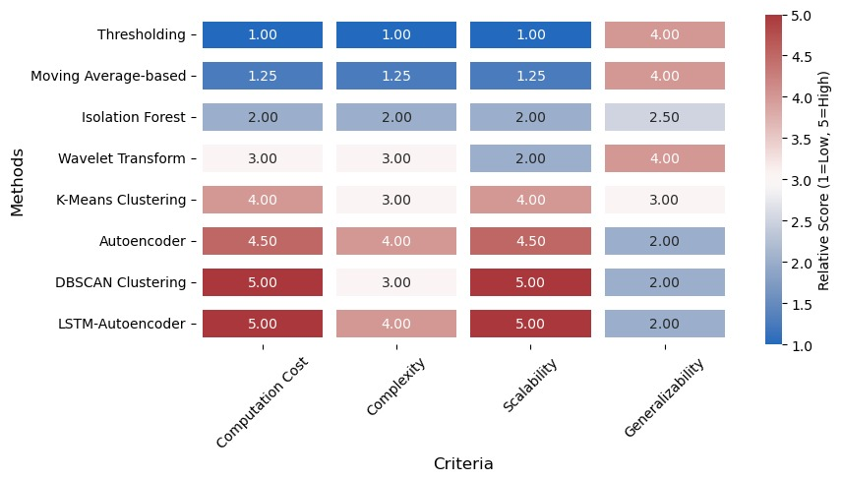
1.
2.
3.
4. Evaluation
5.
Computational Cost, Complexity and Generalizability
Draft
Peak Detection in Time Series | N. Weidemann, N. Wijemanne

Slide 32
1.
2.
3.
4. Evaluation
5.
Best practice: Threshold-Based Detection
Best results based of visual inspections
Fast computation with low resource allocation
Few parameters to optimize
High precision
Draft
Peak Detection in Time Series | N. Weidemann, N. Wijemanne
Notes:
Feature-processing forces the user to analyze and understand the data, which can already give some insights into the reason for the anomalies
Drawback: struggles to generalize on unprocessed data with different signal-types

Slide 33
1.
Introduction
2.
Methodology
3.
Results
4.
5.
Evaluation
Conclusion
Peak Detection in Time Series | N. Weidemann, N. Wijemanne

Slide 34
1.
2.
3.
4.
5. Conclusion
Recommended workflow
1. Start with a simple method
2. Select and develop suitable input features
3. Optimize the parameters
4. Try a more complex approach
Failure
Success
Done
Peak Detection in Time Series | N. Weidemann, N. Wijemanne

Slide 35
1.
2.
3.
4.
5. Conclusion
Findings
Anomalies are likely caused by sudden changes in the commanded speed
Sharp edges seem to cause the peaks in the current
There seems to be an issue within the planning unit
Peak Detection in Time Series | N. Weidemann, N. Wijemanne
Notes:
commanded speed: speed setpoint from the trajectory planner to the motor controller
Spindle signal looks like a discrete signal with hard edges (instead of smooth, continuous transitions

Slide 36
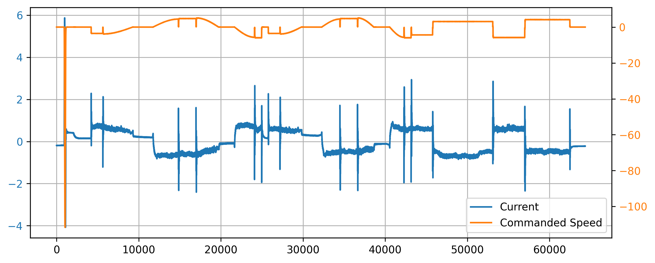
1.
2.
3.
4.
5. Conclusion
3 different types of anomalies
Large outlier
Signal flickers to zero
Jumping between quantized levels
1.
2.
3.
Peak Detection in Time Series | N. Weidemann, N. Wijemanne

Slide 37
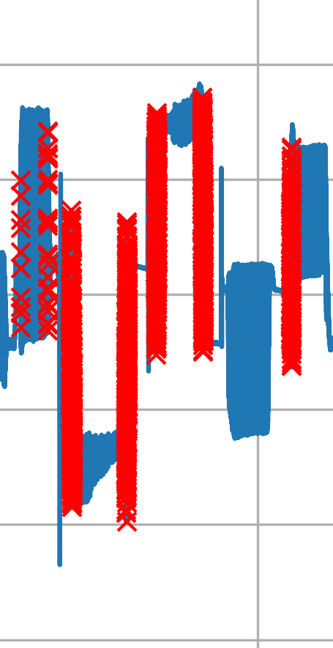

1.
2.
3.
4.
5. Conclusion
Ideas for improvement
Consider the width of each peak and its proximity to neighboring peaks
Rescale the signals by a material-specific factor
Cluster formation: peaks that are close to each other are combined
Peak Detection in Time Series | N. Weidemann, N. Wijemanne
Notes:
Rescale the signals by a material-specific factor to align dynamics in the current caused by normal workload within the same zone to improve generalization
Cluster formation (Coalescence): peaks that are close to each other (within a window distance k) are combined so that only the highest peak remains
(Apply smoothing to the signal to filter noise and remove unsignificant peaks)

Slide 38
Peak Detection in Time Series
Presentation of Final Results
Thank You For Your Attention!
Nestor Weidemann
Mail: nestor.weidemann@st.ovgu.de
Nathira Wijemanne
Mail: nathira.wijemanne@st.ovgu.de

Slide 39
References for Graphics
[1] https://www.hubs.com/de/wissensbasis/3d-druck-vs-cnc-bearbeitung/
[2] https://www.fptindustrie.com/deu/
[3] https://www.mdpi.com/1996-1073/17/15/3659
[4] https://en.wikipedia.org/wiki/Topographic_prominence
[5] https://en.wikipedia.org/wiki/Ricker_wavelet
[6] https://www.researchgate.net/figure/Convolution-of-a-signal-with-a-wavelet-function-Part-of-this-figure-is-taken-from-1_fig1_51918746
[7] https://blog.dailydoseofds.com/p/the-limitations-of-dbscan-clustering
[8] https://www.researchgate.net/figure/Pareto-front-distribution-of-the-optimization-problem_fig1_374617028
Peak Detection in Time Series | N. Weidemann, N. Wijemanne
Notes:
Clustering method -> Hyper parameter tuning
Autoencoder ->
Pseudo labels for evaluation for each approach
Considering efficiency and computational cost when evaluating

Slide 40
Adapt names in footer depending on who is presenting
Peak Detection in Time Series | N. Weidemann, N. Wijemanne

Slide 41
Backup
Peak Detection in Time Series | N. Weidemann, N. Wijemanne

Slide 42

F1-Score
Combines precision and recall into one metric
$F1 Score=2∗\frac{Precision∗Recall}{Precision+Recall}$
$Precision=\frac{TP}{TP+FP}$
$Recall=\frac{TP}{TP+FN}$
Peak Detection in Time Series | N. Weidemann, N. Wijemanne

Slide 43
Dataset
Number of Rows: ~1.6 Million
Time Series data across:
2 Machine Types (CMX1, DMC2)
2 Materials (AL, S)
2 Components (CP1, CP2)
-> 8 different measurements
Variables measured across 4 axes: X (1), Y (2), Z (3) and Spindle (6)
Target Variable: Current
Possible Input Variables: Load, Motor shaft positions (actual & desired), Control deviation, Torque, Feedforward velocity, Feedforward torque, Commanded Speed, and etc.
Peak Detection in Time Series | N. Weidemann, N. Wijemanne

Slide 44
Dataset
Relationships:
For all axes: Current ∝ Torque
For all Z: Current ∝ Load (>0.9 correlation)
Machine CMX1, Spindle: Current ∝ Load (>0.9 correlation)
Machine DMC2, Y & Z: Current ∝ Encoder Positions (>0.9 correlation)
Component 2, Y: Current ∝ Load (>0.9 correlation)
Component 1, Spindle: Current ∝ Load (~0.7 correlation)
Peak Detection in Time Series | N. Weidemann, N. Wijemanne

